Slide 1
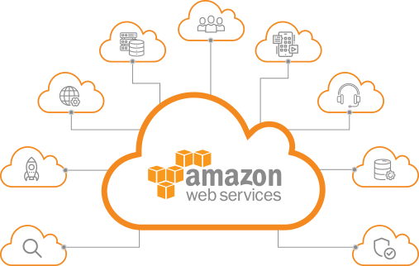
307401 Big Data
Introduction to AWS Data Engineering
2024-2

Slide 2
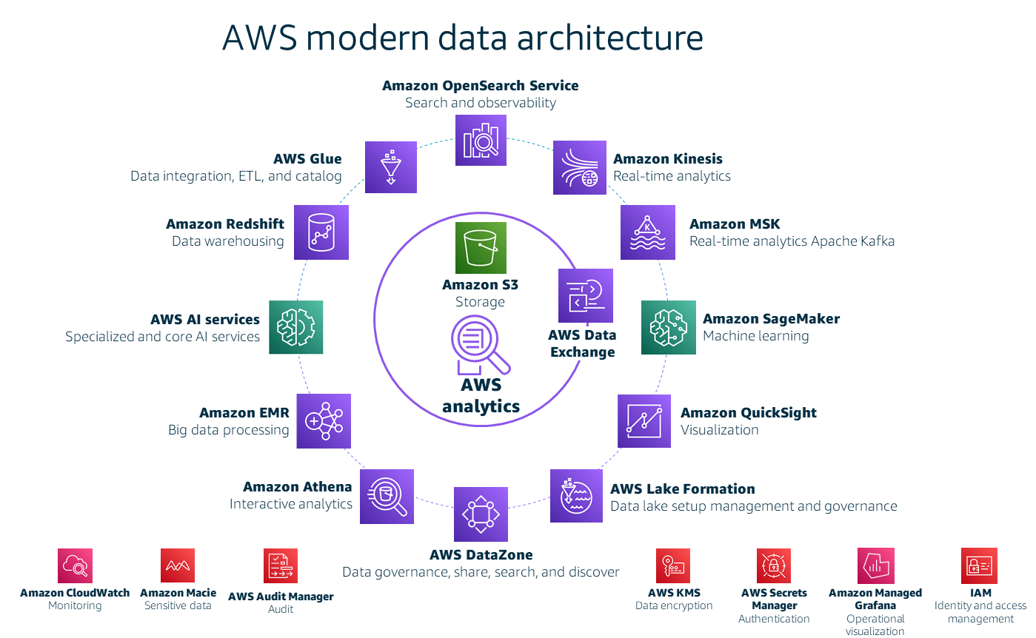
Overview of AWS Data Engineering
Data Engineering: Design and build systems for collecting, storing, and analyzing data.
Purpose: Transform raw data into actionable insights using robust, scalable, and secure data pipelines.
Core AWS Services:
S3: Scalable object storage for raw/staged/curated data.
Glue: Serverless data integration (ETL), data cataloging.
Athena: Serverless querying on S3 using SQL.
Redshift: Data warehousing and analytics.
Kinesis: Real-time data streaming.
Lambda: Serverless compute for lightweight ETL.
EMR: Managed Hadoop/Spark clusters.
Data Pipeline / Step Functions: Workflow orchestration.

Slide 3



A data pipeline in its simplest terms
The data pipeline is the infrastructure that you build to support data-driven decision-making.
At the most basic level, any data pipeline infrastructure must be able to (1) bring data in, (2) store it, and (3) provide the means to work with the data to derive insights.
As the data engineer or data scientist, it's your job to build the pipeline to figure out what's appropriate and how you're going to do it.
Often this will include exploring and experimenting to get to know the data and the best way to derive value from it.
Collect data
Store and process data
Build something useful with data
Notes:
|Slide number 3
|Instructor notes
|Modules 3 and 4 will iterate further on this topic. Those modules will apply more technical details about the types of data and data processing, and match that information to the AWS services and reference architectures that will be used. The goal of this section is to introduce the high-level vocabulary and provide a simplified analogy by using plastic building blocks. It might be helpful to return to this analogy as the course becomes more complex. Modules 6–11 will go deeper into each individual layer and the services and considerations that impact design of that layer.
|
|Student notes
The data pipeline is the infrastructure that you build to support data-driven decision-making. At the most basic level, any data pipeline infrastructure must be able to bring data in, store it, and provide the means to work with the data to derive insights. As the data engineer or data scientist, it's your job to build the pipeline to figure out what's appropriate and how you're going to do it. Often this will include exploring and experimenting to get to know the data and the best way to derive value from it.

Slide 4

Work backwards to design your infrastructure
The number of variations and options to create a data pipeline are broad.
The key to designing an effective decision-making infrastructure is to start with the business problem to be solved or decision to be made.
Then, build the pipeline that best suits that use case.
The cloud makes it easier to start up different infrastructure to serve different use cases.
An organization doesn't need to invest in an infrastructure that tries to serve all business needs with a single database, server, or technology stack.
For each use case, start with the end in mind, and build the data pipeline that supports it.
2. What data do you need to support this?
1. What decision are you trying to make?
Weigh the trade-offs of cost, speed, and accuracy.
Notes:
|Slide number 4
|Instructor notes
|
|Student notes
The number of variations and options to create a data pipeline are broad. The key to designing an effective decision-making infrastructure is to start with the business problem to be solved or decision to be made. Then, build the pipeline that best suits that use case. The cloud makes it easier to start up different infrastructure to serve different use cases. An organization doesn't need to invest in an infrastructure that tries to serve all business needs with a single database, server, or technology stack. For each use case, start with the end in mind, and build the data pipeline that supports it.

Slide 5




Layers of the pipeline infrastructure
The infrastructure layers that you need to build include methods to ingest and store data from the data sources that you have identified.
You need to make the stored data accessible for decision-making processes.
You must also create the infrastructure to process, analyze, and visualize data by using tools that are appropriate to the use case.
To build an appropriate infrastructure, you will need to understand the nature of the data and the intended type of processing and analysis to be performed.
Storage
Data sources
Predictions and decisions
Ingestion
Analysis & Visualization
Processing
Notes:
|Slide number 5
|Instructor notes
|
|Student notes
The infrastructure layers that you need to build include methods to ingest and store data from the data sources that you have identified. You need to make the stored data accessible for decision-making processes. You must also create the infrastructure to process, analyze, and visualize data by using tools that are appropriate to the use case. To build an appropriate infrastructure, you will need to understand the nature of the data and the intended type of processing and analysis to be performed.

Slide 6
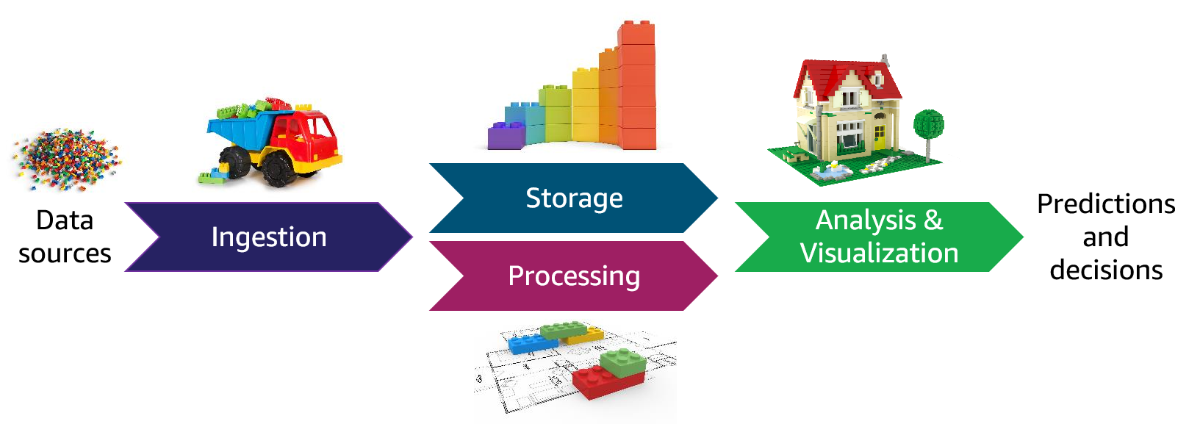
Actions taken with data in the pipeline
The pipeline must support the ability to discover details about the data and how it fits (or doesn't fit) your intended outcomes.
You might start with a hypothesis and use BI tools or other mechanisms to discover more information about the data, and then experiment and see where it takes you.
Data will almost always be transformed as it moves through the pipeline. This might include modifying the format to support a specific analysis tool or replacing values (for example, zeroes in place of nulls).
Data wrangling is a term that is used to describe the ways in which data is manipulated and transformed from its raw state into more meaningful states that downstream processes or users can use.
Data wrangling: Discover
Clean
Normalize
Enrich
Transformation
Notes:
|Slide number 6
|Instructor notes
|This slide includes an animation that runs automatically when you present the slide. It moves the data wrangling circle across the pipeline illustrating that data wrangling happens in multiple stages across the pipeline. |
|Student notes
Looking at the pipeline from the perspective of the data that travels through it, the pipeline must support the ability to discover details about the data and how it fits (or doesn't fit) your intended outcomes. You might start with a hypothesis and use BI tools or other mechanisms to discover more information about the data, and then experiment and see where it takes you.
Data might need to be cleaned or normalized. For example, you might merge multiple data sources that share some similar data and you need to rectify inconsistencies, or you might have a data source that hasn't been well-maintained or validated at its source. You need to prepare the data before it's viable for analysis.
Data will almost always be transformed as it moves through the pipeline. This might include modifying the format to support a specific analysis tool or replacing values (for example, zeroes in place of nulls). You might also augment the dataset by filling in gaps or enriching it with additional information. For example, you might calculate and save additional data values to be used during analysis. You might also add metadata to categorize and catalog data. Data wrangling is a term that is used to describe the ways in which data is manipulated and transformed from its raw state into more meaningful states that downstream processes or users can use.
Within each layer, or as part of transitioning between pipeline layers, you might perform these tasks on data to prepare it for the desired analysis or predictions. Some task types can happen in multiple places across the pipeline, and some tasks can be performed together as part of a single process. For example, in traditional data science architectures, the extract, transform, and load (ETL) process takes data from one source, performs some type of transformation on it, and then loads it into another location where the analysis is done.
As you learn about different scenarios, you will see these tasks performed at different points in the pipeline, using different services and methods dependent on the uses case.
The tools that you use and the way you perform these tasks will differ based on characteristics of your data, the business problem that you're addressing, and the methods or models that you're applying.

Slide 7
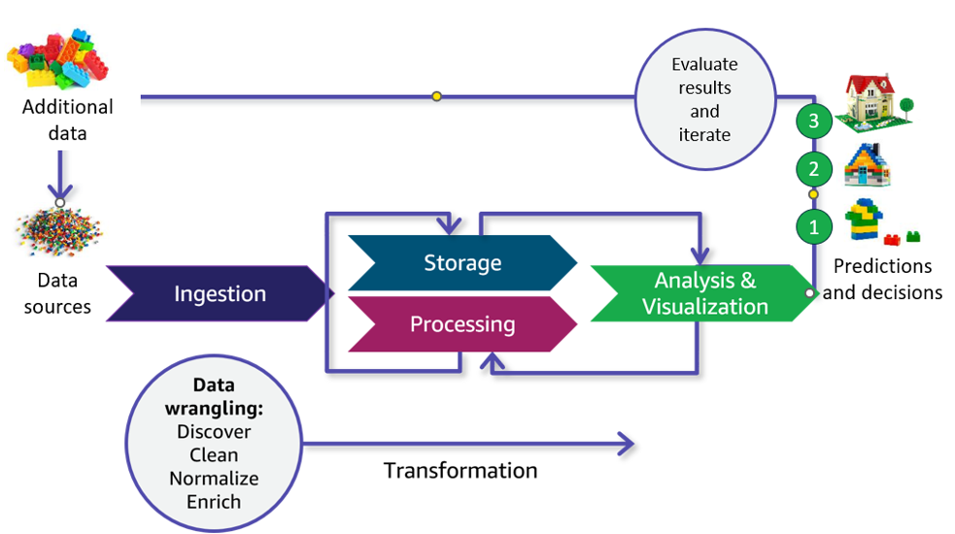
Iterative processing through the pipeline
Another key characteristic of deriving insights by using your data pipeline is that the process will almost always be iterative.
For example, in this illustration, the initial iteration (number 1) yielded a result that wasn't as defined as was desired. Therefore, the data scientist refined the model and reprocessed the data to get a better result (number 2).
After reviewing those results, they determined that additional data could improve the detail available in their result, so an additional data source was tapped and ingested through the pipeline to produce the desired result (number 3).
Notes:
|Slide number 7
|Instructor notes
|
|Student notes
Another key characteristic of deriving insights by using your data pipeline is that the process will almost always be iterative. You have a hypothesis about what you expect to find in the data, and you need to experiment and see where it takes you. You might develop your hypothesis by using BI tools to do initial discovery and analysis of data that has already been collected. You might iterate within a pipeline segment, or you might iterate across the entire pipeline. For example, in this illustration, the initial iteration (number 1) yielded a result that wasn't as defined as was desired. Therefore, the data scientist refined the model and reprocessed the data to get a better result (number 2). After reviewing those results, they determined that additional data could improve the detail available in their result, so an additional data source was tapped and ingested through the pipeline to produce the desired result (number 3).
A pipeline often has iterations of storage and processing. For example, after the external data is ingested into pipeline storage, iterative processing transforms the data into different levels of refinement for different needs.

Slide 8

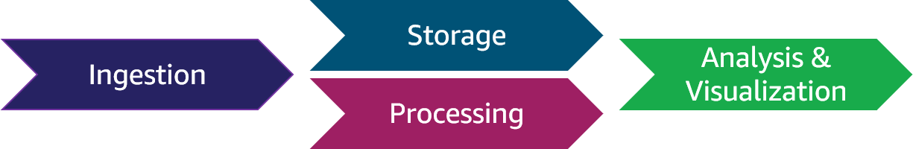

Common data pipeline questions
Does the organization have the data that addresses the need? Where is the data stored and in what format?
Will I need to combine data from multiple sources?
What is the type and quality of data? What will be the source of truth?
What are the security requirements for this data? Who needs access to it and in what state?
What types of mechanisms are needed to transfer the data from its locations into the pipeline?
How much data is there, and how frequently is it updated or processed?
How important is speed when data is requested?
Data engineer
What can the data tell me?
How will I evaluate the results?
What kind of visualization do I need?
Which formats and tools are the analysts familiar with?
Do I need a big data framework?
Which type of AI/ML models fit?
What is the simplest way to implement AI/ML?
Data scientist
Notes:
|Slide number 8
|Instructor notes
|This slide is a baseline setup for activities that the student will perform throughout the course. You might withhold the questions and instead treat this as a precursor to the data module that follows. The slide is animated to support withholding the questions and treating this as a discussion.
|Ask students to think of the type of questions that they believe will need to be answered by the data engineer based on what they have learned so far.
|
|Student notes
To build the correct pipeline, the person responsible for building the pipeline needs to ask a lot of questions about the nature of the data and the intent for its processing. You can classify the questions broadly into data engineering questions, which are mostly focused on getting the data into the pipeline, and data science questions, which are mostly about what you are trying to get out of the data.
In the remainder of this course, you will learn how the answers to these types of data engineering questions lead you to select components and build pipelines that provide the appropriate infrastructure for data-driven decisions.

Slide 9

Key takeaways: The data pipeline – infrastructure for data-driven decisions
A data pipeline provides the infrastructure for data-driven decision-making.
When designing a pipeline, start with the business problem to be solved and work backwards to the data.
The pipeline includes layers to ingest, store, process, and analyze and visualize data passing through it.
Data wrangling refers to how data is acted upon as it passes through the pipeline. Tasks include discovery, cleaning, normalization, transformation, and augmentation.
Data is processed iteratively to evaluate and improve upon results.
Notes:
|Slide number 9
|Instructor notes
|
|Student notes
Here are a few key points to summarize this section:
The data pipeline provides the infrastructure for data-driven decisions and includes layers to ingest, store, process, and analyze and visualize data.
Data wrangling refers to the work to transform data to prepare it for analysis. Processing is typically iterative. The business problem should drive the pipeline design.

Slide 10


Slide 11
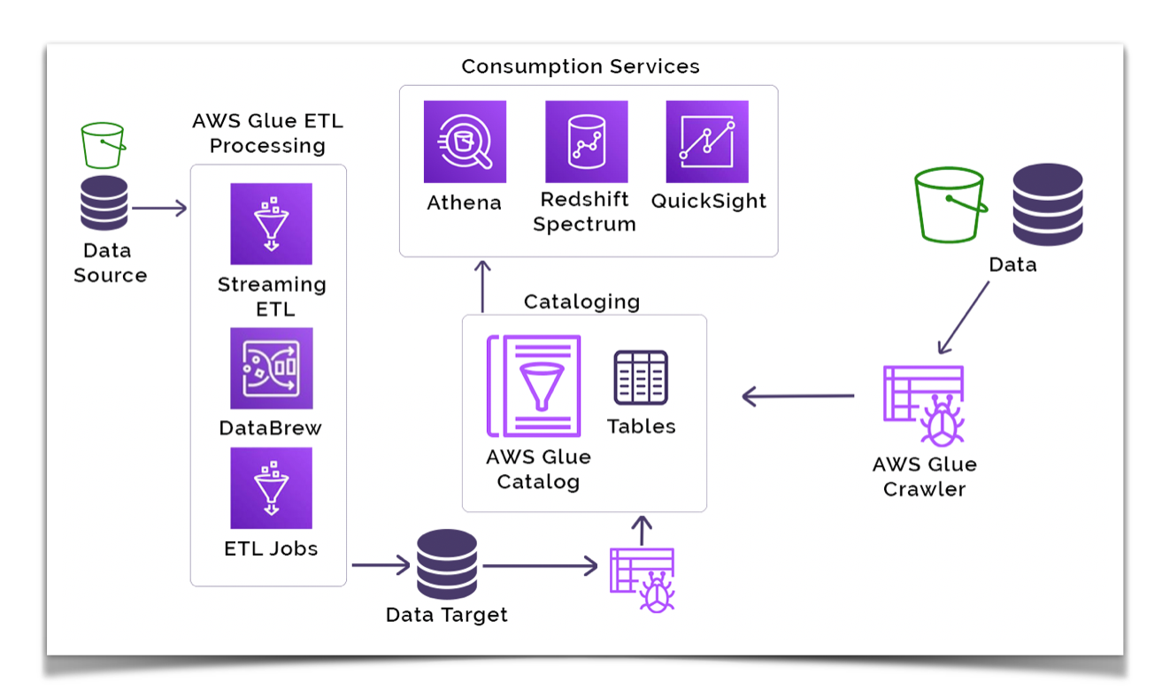

Slide 12
Introduction to AWS Glue
What is AWS Glue?
AWS Glue is a fully managed, serverless data integration service that simplifies the process of discovering, preparing, and combining data for analytics, machine learning, and application development.
Key Features:
Serverless Architecture: No infrastructure to manage; AWS handles provisioning and scaling.
Data Cataloging: Centralized metadata repository for all data assets.
Automated ETL: Automatically generates code to extract, transform, and load data.
Support for Multiple Data Sources: Integrates with various AWS and third-party data sources.

Slide 13
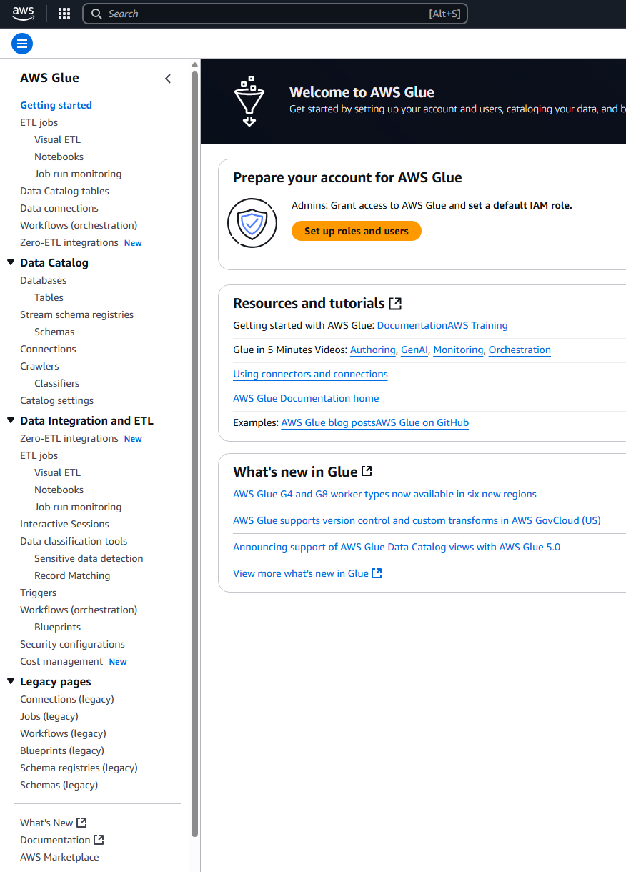
Core Components of AWS Glue
1. AWS Glue Data Catalog: A centralized metadata repository that stores table definitions, job metadata, and other control information to manage your ETL environment.
2. Crawlers: Automated processes that scan data sources to infer schemas and populate the Data Catalog.
3. Jobs: Scripts that define the ETL process, written in Python or Scala, which can be generated automatically or customized.
4. Triggers: Mechanisms to initiate jobs based on schedules or events.
5. Workflows: Orchestrate multiple jobs and crawlers to build complex ETL pipelines.
6. Transformers: Built-in and custom data transformation functions.

Slide 14
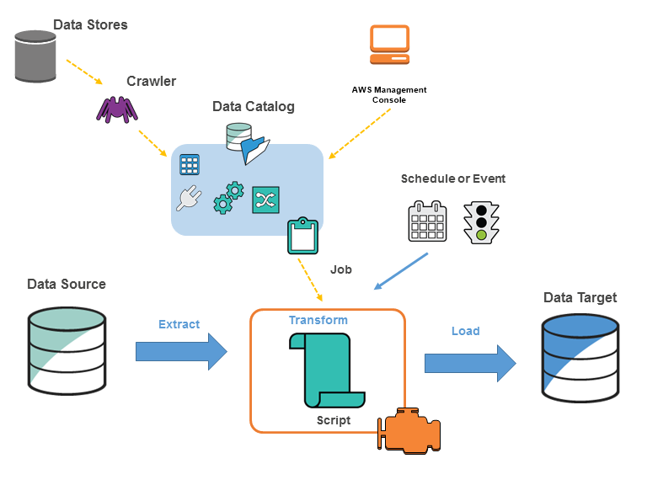

Slide 15
AWS Glue Data Catalog
Purpose:
Acts as a persistent metadata store for all your data assets, enabling data discovery and schema management.
Features:
Schema Versioning: Tracks changes to data schemas over time.
Integration: Works seamlessly with Amazon Athena, Redshift Spectrum, and Amazon EMR.
Security: Supports fine-grained access control using AWS Identity and Access Management (IAM).

Slide 16
AWS Glue Crawlers
Functionality:
Connect to various data sources, infer schemas, and populate the Data Catalog with metadata.
Supported Data Stores:
Amazon S3, Amazon RDS, Amazon Redshift, DynamoDB, and more.
Custom Classifiers:
Define custom logic to classify data formats not supported by default.

Slide 17
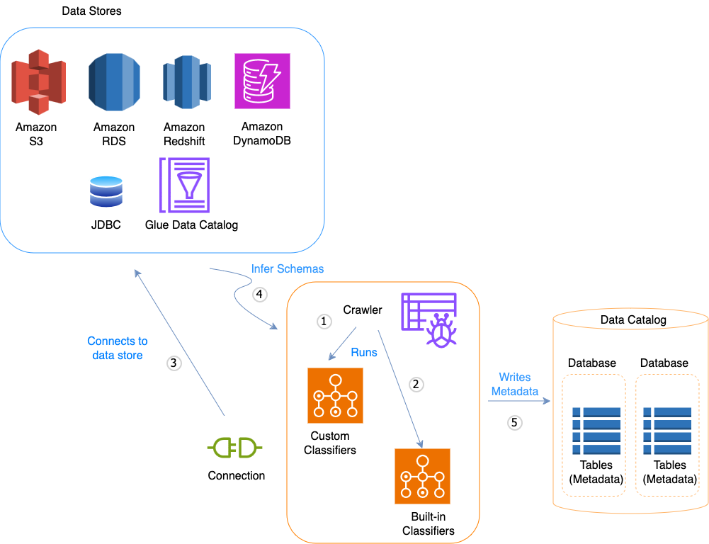

Slide 18
AWS Glue Jobs
Types of Jobs:
ETL Jobs: Perform extract, transform, and load operations.
Streaming Jobs: Process real-time data streams using Apache Spark Structured Streaming.
Development Options:
AWS Glue Studio: Visual interface to create and manage jobs.
Script Editor: Write custom scripts in Python or Scala.
Job Monitoring:
Track job runs, monitor logs, and set up alerts for failures or delays.

Slide 19
Triggers and Workflows
Triggers:
Scheduled Triggers: Initiate jobs at specified times.
Event-Based Triggers: Start jobs in response to events like new data arrival.
Workflows:
Define a sequence of jobs and crawlers with dependencies to automate complex ETL processes.

Slide 20
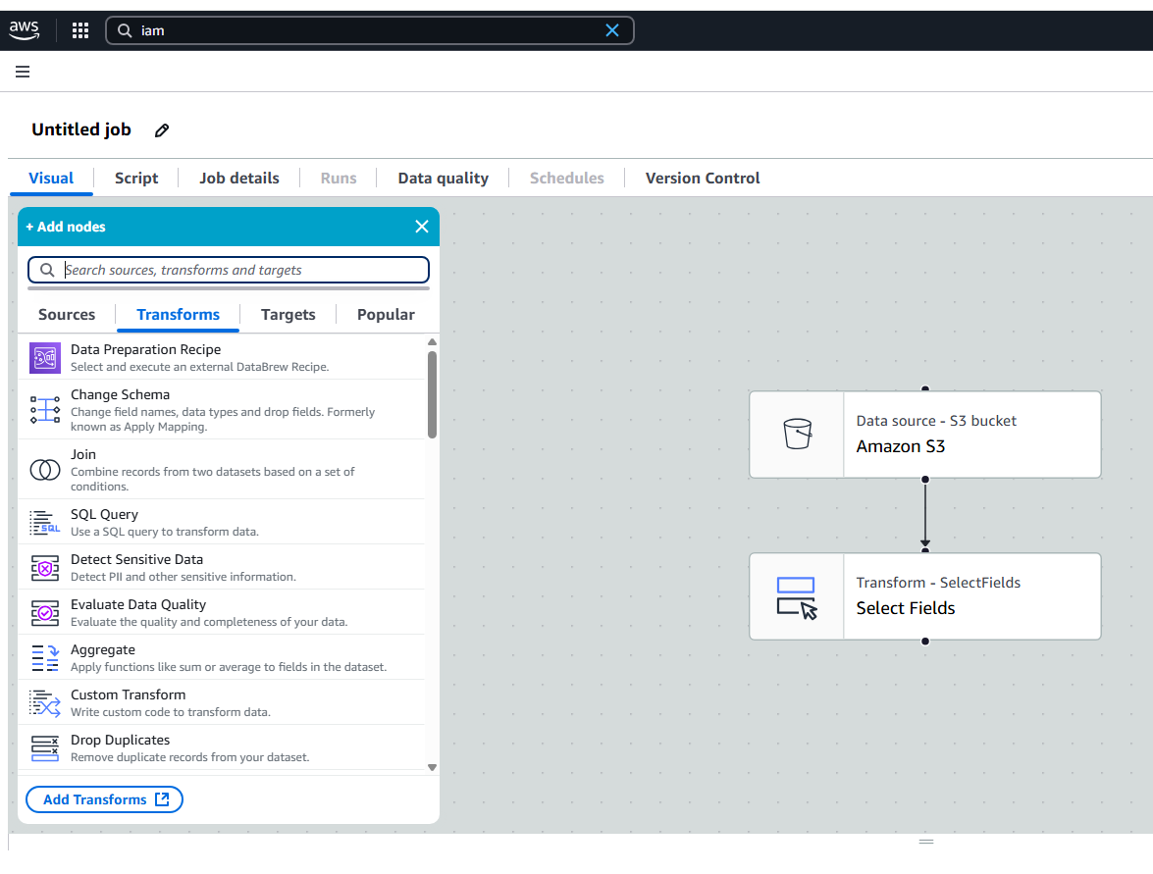
AWS Glue Studio
Features:
User-friendly interface to create, run, and monitor ETL jobs without writing code.
Drag-and-drop functionality to design data flows.
Automatic code generation with the option to customize scripts.

Slide 21
AWS Glue DataBrew
Overview:
Visual data preparation tool for data analysts and scientists.
Capabilities:
Clean and normalize data without writing code.
Apply transformations, handle missing values, and create data profiles.

Slide 22
Integration with Other AWS Services
Amazon S3:
Store and retrieve data for processing.
Amazon Redshift:
Load transformed data into Redshift for analytics.
Amazon Athena:
Query data directly from S3 using SQL.
Amazon EMR:
Process large datasets using big data frameworks like Apache Spark and Hadoop.

Slide 23
Security and Compliance
Data Encryption:
Supports encryption at rest and in transit.
Access Control:
Fine-grained permissions using IAM roles and policies.
Audit Logging:
Integration with AWS CloudTrail for monitoring API calls and user activities.

Slide 24


Slide 25
Introduction to Amazon Athena
What is Athena?
A serverless query service for directly analyzing data in Amazon S3 using standard SQL.
No infrastructure to set up or manage — you pay only for the data scanned per query.
Trino and Athena
Athena is built on the open-source Trino query engine
Trino (formerly PrestoSQL) enables fast, scalable query processing
Distributed SQL query engine for big data processing
Main Advantages:
Ad hoc querying: instantly run queries without ETL pipelines.
Data exploration and discovery
Serverless analytics
Support for various formats: CSV, JSON, ORC, Parquet, Avro.
Integration with AWS Glue for metadata management.
Security: IAM controls query and data access.

Slide 26
How Athena Works
Architecture Overview:
Data is stored in Amazon S3.
Metadata is stored in AWS Glue Data Catalog or internal Athena catalog.
SQL engine processes queries via a distributed serverless backend (based on Presto).
Query Flow:
Define table schema (pointing to S3 location).
Submit SQL query via Athena console, SDK, or CLI.
Query results are returned; metadata is stored.

Slide 27
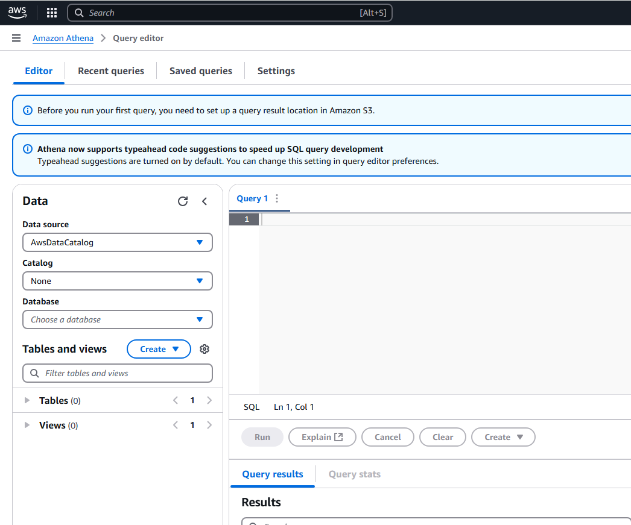
Core Components of Amazon Athena
1. Data Sources:
Primarily queries data stored in Amazon S3.
Supports various data formats, including CSV, JSON, ORC, Avro, and Parquet.
2. Query Engine:
Built on Presto, an open-source distributed SQL query engine optimized for low-latency data analysis.
3. Integration with AWS Glue:
Utilizes AWS Glue Data Catalog for managing metadata and schema definitions.

Slide 28
Athena and S3 Integration
Data Source:
Athena only reads data from Amazon S3.
Common File Formats:
CSV, JSON, ORC, Parquet, Avro, and more.
Performance Considerations:
Columnar formats like Parquet and ORC reduce data scanned.
Partitioning directories in S3 improves performance.
Cost Optimization:
Compress and partition data to reduce scan size.

Slide 29
AWS Glue Data Catalog Integration
Glue’s Role:
AWS Glue crawls and catalogs data in S3
Makes data discoverable by Athena for querying
Acts as a central metadata repository for Athena.
Athena + Glue Integration:
Athena can use Glue tables, databases, and crawlers.
Enables table reuse and consistency across AWS services.
Glue Crawlers:
Automatically detect schema from S3 data and create metadata tables.

Slide 30
Schema Evolution in Athena
Athena supports schema-on-read approach
Dynamically infers structure during query execution
Handles schema changes without explicit alterations
New field addition doesn't break existing queries
AWS Glue Crawler updates metadata after schema changes
SCHEMA EVOLUTION EXAMPLE
Assume you have an Athena Table defined
When a new field is added to the source data:
Queries will still work with fields in original definition
To access new field data, table DDL must be updated

Slide 31
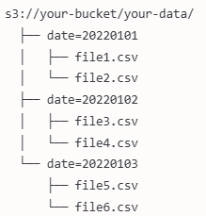
Partitioning in Athena
Organizes data based on specific column values
Creates subdirectories in S3 for each partition value
Enhances query performance by skipping irrelevant data
Best Practice: Partition by date for time-series data
CHOOSING PARTITION KEYS
Pick keys that support common query filters
Use columns with relatively low cardinality
Avoid heavily skewed partition values
Time-based partitioning works well for growing datasets
OPTIMIZING QUERY PERFORMANCE
Appropriate File Formats: Use columnar formats (Parquet, ORC)
Partitioning: Organize data to skip unnecessary scans
Predicate Pushdown: Use filters in WHERE clause
Bucketing: Organize data within partitions
Control Data Volume: Limit time ranges, use sampling

Slide 32
Predicate Pushdown in AWS Athena
Predicate pushdown is a query optimization technique used in AWS Athena that significantly improves query performance by reducing the amount of data that needs to be scanned and processed.
How Predicate Pushdown Works
Filter Application at Source: When you include filter conditions in the WHERE clause of your query, these conditions (predicates) are "pushed down" to the data source level.
Early Data Filtering: Instead of loading all data and then filtering it, the conditions are applied while reading the data, which means only relevant data is loaded.
Metadata Utilization: For columnar formats like Parquet and ORC, Athena uses file metadata (min/max values per column in each file block) to determine which data blocks can be skipped entirely.

Slide 33
Example
SELECT customer_name, order_total FROM orders WHERE order_date > '2023-01-01' AND region = 'EMEA’;
With predicate pushdown:
Athena can skip reading any file blocks where the min/max values for 'order_date' indicate all values are before 2023-01-01
Similarly, it can skip blocks where 'region' does not contain 'EMEA’
Benefits
Reduced Data Scanning: Only relevant data blocks are read
Lower Costs: AWS Athena charges based on amount of data scanned
Faster Queries: Less data to process means faster execution time
Improved Scalability: More efficient resource utilization
Best Practices
Use file formats that support predicate pushdown (Parquet, ORC)
Structure your WHERE clauses to filter as early as possible in the query
Sort data on frequently filtered columns when writing to S3
Partition data to complement predicate pushdown for compound performance gains
Predicate pushdown is one of the most effective techniques for optimizing Athena queries, especially when working with large datasets.

Slide 34
Optimizing Queries with Compression, Buckets, and Partitions
Buckets
Definition: Logical grouping of related records based on high-cardinality fields.
Purpose: Speed up query performance by minimizing full dataset scans.
Example: Splitting taxi trips into separate buckets by each day's timestamp.
Compression
Purpose: Store data using compressed formats (e.g., GZIP, Parquet) to:
Save S3 storage space.
Reduce the amount of data Athena scans (saving cost).
Partitioning
Definition: Splitting data into logical directories based on low-cardinality fields.
Example: Partitioning taxi trips by payment type (Credit card, Cash).
"Athena's cost is based on data scanned — so optimizing file formats and partitions can massively reduce costs in Big Data environments."

Slide 35
Optimizing Queries with Compression, Buckets, and Partitions
Technique | Best for | Example | Benefit
Compression | Any large dataset | Compress CSV to GZIP | Lower storage and scan costs
Bucketing | High cardinality fields | Group by pickup timestamp | Speed up random queries
Partitioning | Low cardinality fields | Split by payment type | Scan only relevant partitions
Golden Rule: Less data scanned = Faster query + Lower cost
Note: Buckets in compression is different than S3 storage buckets
Term | Meaning | Context
S3 Buckets | Storage containers in Amazon S3 to hold files (objects). | Cloud storage. Think: folders for storing any type of data (CSV, images, backups).
Bucketing (in Athena/Glue/Presto SQL) | A data organization technique: splitting data into logical groups ("buckets") based on the values of a column. | Database optimization. Think: dividing a huge table into smaller "mini-tables" inside a database to speed up queries.

Slide 36
Handling Large Files
Use appropriate file formats (Parquet/ORC)
Implement effective partitioning strategies
Apply bucketing for high-cardinality columns
Control query scope with filters
Use columnar compression
Create a Table with Partition in Athena
CREATE EXTERNAL TABLE sales_records ( product_id INT, sales_amount DECIMAL(10, 2), transaction_date DATE )
PARTITIONED BY (year INT, month INT)
LOCATION 's3://your-bucket/sales-data/';

Slide 37
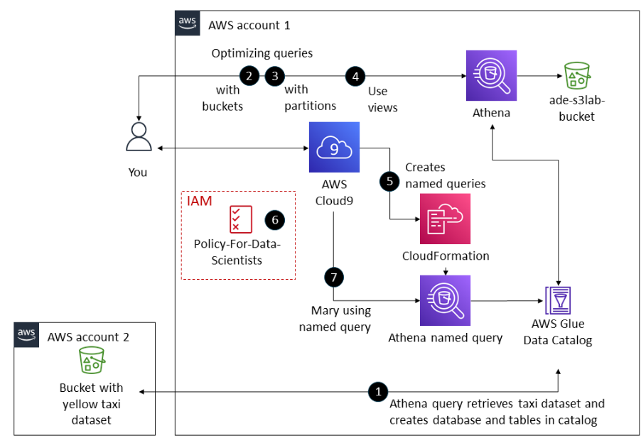
Module 4 Lab: Querying Data Using Amazon Athena
In this lab, you will learn to query CSV data stored in Amazon S3 using Amazon Athena and AWS Glue.
Athena enables SQL queries on S3 data without moving it, while Glue helps define and manage metadata.
You will implement a lab in AWS Academy Data Engineering Course (Module 4) where we simulate the role of a data scientist building a scalable, permission-controlled solution that supports team-wide access following the principle of least privilege.
Objectives
You will:
Create a Glue database and table via the Athena editor
Define schema and use bulk column features
Query and optimize data in S3 with Athena
Create views and named queries
Deploy named queries using CloudFormation
Validate IAM access through AWS CLI
This training uses a 2017 taxi trip dataset and is restricted to required AWS services only.

Slide 38
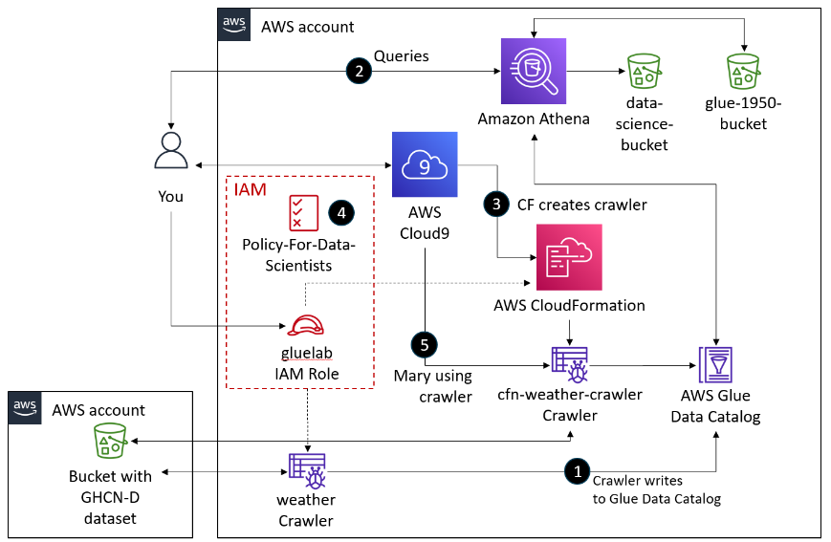
Module 7 Lab: Performing ETL on a Dataset by Using AWS Glue
In this lab, you will learn how to use AWS Glue to import a dataset from Amazon Simple Storage Service (Amazon S3).
You will then extract the data, transform its schema, and load the dataset into an AWS Glue database for later analysis by using Athena.
After completing this lab, you will be able to do the following:
Access AWS Glue in the AWS Management Console and create a crawler.
Create an AWS Glue database with tables and a schema by using a crawler.
Query data in the AWS Glue database by using Athena.
Create and deploy an AWS Glue crawler by using an AWS CloudFormation template.
Review an AWS Identity and Access Management (IAM) policy for users to run an AWS Glue crawler and query an AWS Glue database in Athena.
Confirm that a user with the IAM policy can use the AWS Command Line Interface (AWS CLI) to access the AWS Glue database that the crawler created.
Confirm that a user can run the AWS Glue crawler when source data changes.

Slide 39
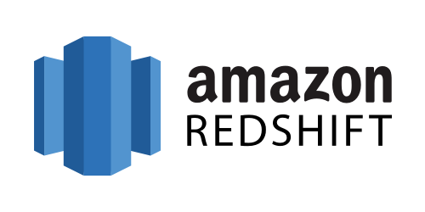

Slide 40
Amazon Redshift
Amazon Redshift is a fully managed data warehouse service offered by Amazon Web Services (AWS).
It is designed for large-scale data storage and fast query performance, making it suitable for data analytics and business intelligence workloads.
Here are some key features and benefits of Amazon Redshift:
Key Features and Benefits:
High Performance:
Redshift uses columnar storage and data compression to reduce the amount of data read from disk, improving query performance.
Massively parallel processing (MPP) architecture allows Redshift to distribute and parallelize queries across multiple nodes.
Scalability:
Redshift allows you to start with a small cluster and scale up to petabytes of data.
You can easily resize your Redshift cluster by adding or removing nodes.
Cost-Effective:
Pay only for the resources you use with on-demand pricing.
Reserved instance pricing and the ability to pause and resume clusters can further reduce costs.
Managed Service:
AWS manages the setup, operation, and scaling of Redshift, including backups, patching, and monitoring.
Automatic backups and snapshots provide data protection and recovery.
Data Integration:
Redshift integrates with various AWS services such as Amazon S3, Amazon RDS, Amazon DynamoDB, and AWS Glue for data ingestion and ETL processes.
Supports integration with third-party ETL tools and BI platforms.
Advanced Analytics:
Supports SQL-based querying and analytics.
Redshift Spectrum allows you to run queries on data stored in Amazon S3 without loading it into Redshift.
Machine learning integration with Amazon SageMaker for predictive analytics.

Slide 41
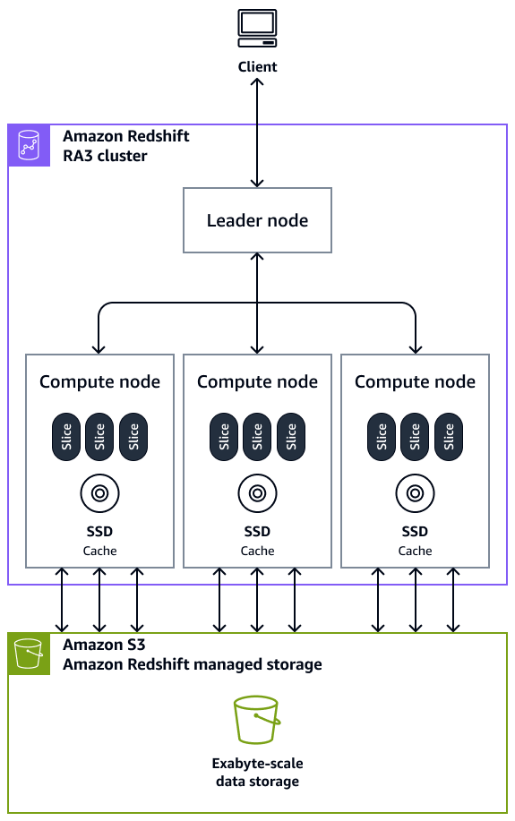
Core Components of Amazon Redshift
1. Clusters:
The core infrastructure component, composed of one or more compute nodes.
2. Leader Node:
Manages communications with client programs and all communication with compute nodes.
3. Compute Nodes:
Handle data processing tasks and store data.

Slide 42
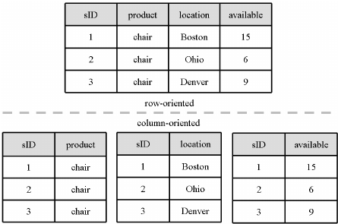
Data Storage and Compression
Columnar Storage:
Data is stored in columns, optimizing query performance and reducing I/O.
Compression:
Redshift applies compression to reduce storage requirements and improve performance.

Slide 43
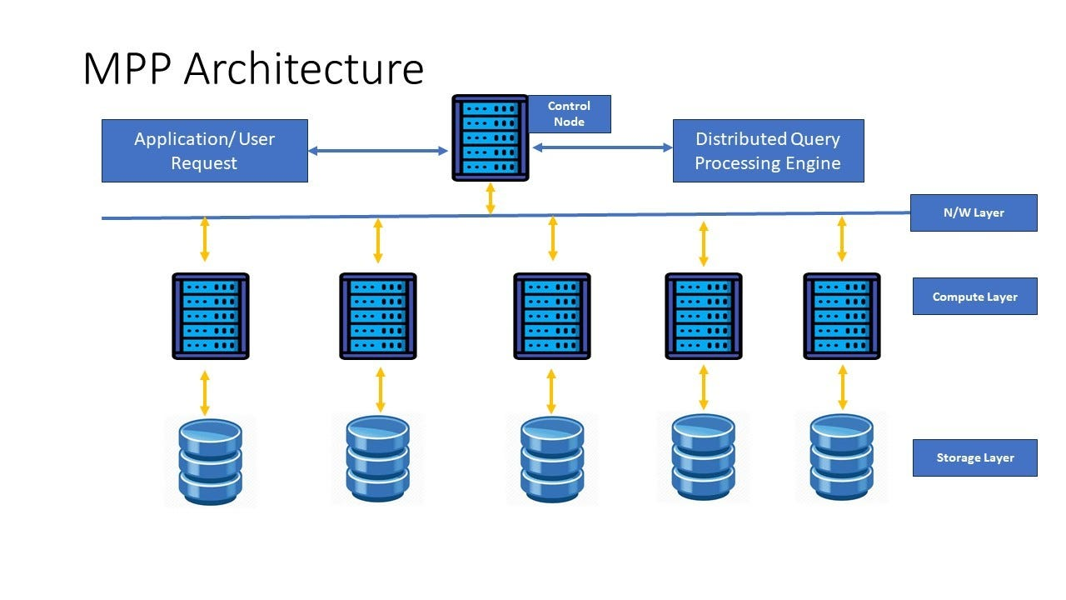
Query Processing and Optimization
Massively Parallel Processing (MPP):
Distributes data and query load across multiple nodes for efficient processing.
Query Optimization:
Redshift's query optimizer evaluates multiple execution strategies and selects the most efficient one.

Slide 44
Redshift Deployment Options
Provisioned Clusters
With provisioned clusters, you manage your Amazon Redshift resources manually. This option gives you complete control over cluster sizing, scaling, and maintenance windows.
Redshift Serverless
Amazon Redshift Serverless lets you access and analyze data without the configurations of a provisioned data warehouse. Resources are automatically provisioned, and capacity is intelligently scaled to deliver fast performance for demanding workloads.
Key benefits of Redshift Serverless:
Automatic resource provisioning: No need to manually configure cluster size
Pay-per-use pricing: You don't incur charges when the data warehouse is idle
Auto-scaling: Capacity adjusts based on workload demands
Simplified management: No need to monitor or tune the cluster
Redshift Serverless organizes resources using namespaces (for database objects) and workgroups (for compute resources). Workgroups house compute resources like Redshift Processing Units (RPUs), security groups, and usage limits.

Slide 45
Setting Up AWS Redshift
Setting Up a Provisioned Cluster
Sign in to AWS Console: Navigate to the Redshift service
Create Cluster: Choose "Create cluster" and configure settings:
Cluster identifier
Node type
Number of nodes
Database configurations (name, port, credentials)
Network and security settings
Maintenance and backup options
Launch Cluster: Review settings and create the cluster
Setting Up Redshift Serverless
Sign in to AWS Console: Navigate to the Redshift service
Create Serverless Workspace: Configure settings:
Namespace name (for database objects)
Workgroup name (for compute resources)
Network and security settings
RPU capacity settings (optional)
Create Workspace: Review settings and create the serverless workspace

Slide 46
Use Cases
Data Warehousing:
Centralized repository for structured and semi-structured data.
Business Intelligence:
Supports integration with BI tools like Tableau, Looker, and Amazon QuickSight.
Machine Learning:
Provides data for training and inference in machine learning models.

Slide 47
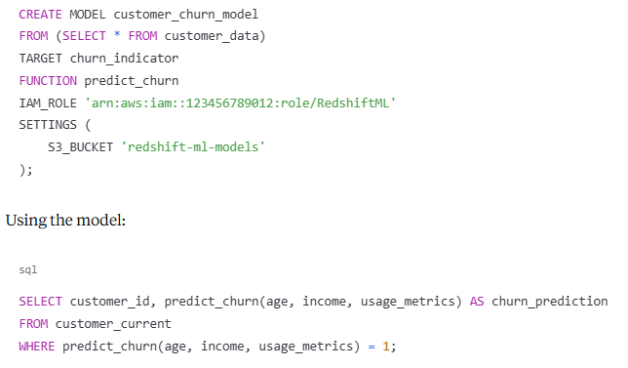
Redshift ML
Amazon Redshift ML makes it easy for data analysts and database developers to create, train, and apply machine learning models using familiar SQL commands. It leverages Amazon SageMaker without requiring users to learn new tools or languages.
Example of creating a model:

Slide 48


Slide 49
Introduction to Amazon EMR
What is Amazon EMR?
Amazon EMR (Elastic MapReduce) is a managed cloud-native big data platform provided by Amazon Web Services (AWS).
It simplifies running big data frameworks, such as Apache Hadoop and Apache Spark, on AWS to process and analyze vast amounts of data.
Key Features:
Scalability: Handles large-scale data sets, allowing dynamic scaling of resources based on workload demands.
Performance: Utilizes distributed processing frameworks to decrease command execution time.
Simplified Management: AWS handles provisioning, configuration, and tuning of clusters
Flexibility: Supports multiple deployment options and various open-source big data frameworks
Integration: Seamlessly integrates with various AWS services like Amazon S3, Amazon RDS, and Amazon DynamoDB.
Security: Integrates with AWS security services for comprehensive protection

Slide 50
Use Cases
Big data processing and analytics
Machine learning
Extract, Transform, Load (ETL) operations
Log analysis
Real-time streaming
Data transformations
Clickstream analysis
Genomics processing
Predictive analytics

Slide 51
EMR Architecture Overview
Core Components
AWS EMR architecture consists of several layers, each providing specific functionality to the cluster:
Storage Layer
Amazon S3 (primary data store)
HDFS (Hadoop Distributed File System)
EMRFS (EMR File System)
Local instance storage
Cluster Layer
Primary Node (formerly Master Node): Manages the cluster and coordinates distribution of data and tasks
Core Nodes: Run tasks and store data in HDFS
Task Nodes: Run tasks but don't store data
Processing Layer
Open-source frameworks like Hadoop, Spark, Hive, and others
EMR-optimized versions of these frameworks

Slide 52
Core Components of Amazon EMR
1. Clusters:
The central component of Amazon EMR, composed of Amazon EC2 instances. Each instance in the cluster is called a node.
2. Node Types:
Primary Node: Manages the cluster by running software components to coordinate the distribution of data and tasks among other nodes for processing.
Core Node: Runs tasks and stores data in the Hadoop Distributed File System (HDFS) on your cluster.
Task Node: Runs tasks but does not store data in HDFS. Task nodes are optional.

Slide 53
Data Storage and Processing
Storage Options:
Amazon S3: EMR File System (EMRFS) allows EMR clusters to directly access data stored in Amazon S3 as if it were a file system like HDFS.
HDFS: A distributed and scalable Hadoop file system enabling data distribution across instances in the cluster.
Processing Frameworks:
Apache Hadoop MapReduce: An open-source programming model for distributed computing.
Apache Spark: A cluster framework and programming model for processing big data workloads, supporting multiple interactive query modules such as SparkSQL

Slide 54
EMR Studio and Notebooks
EMR Studio:
An integrated development environment (IDE) that makes it easy for data scientists and data engineers to develop, visualize, and debug data engineering and data science applications written in R, Python, Scala, and PySpark.
EMR Notebooks:
Provides a managed environment based on Jupyter Notebooks for interactive data analysis and visualization.

Slide 55
Deployment Options
AWS EMR offers four distinct deployment options to meet different operational requirements:
1. EMR on EC2
The traditional deployment model where EMR runs on Amazon EC2 instances.
Key features:
Full control over cluster configuration and instance selection
Customizable AMIs (Amazon Machine Images)
Ability to install custom software
Ideal for workloads requiring specific hardware configurations
Use when:
You need maximum control and flexibility
You want to customize underlying infrastructure
You need specific EC2 instance types for performance optimization

Slide 56
Deployment Options
A serverless deployment option that eliminates the need to configure, manage, or scale clusters.
Key features:
Automatic resource provisioning and scaling
Pay only for resources used by your applications
Zero infrastructure management
Currently supports Apache Spark and Apache Hive
Use when:
You want to simplify operations
You have variable or unpredictable workloads
You want to avoid managing clusters
You prefer focusing on applications rather than infrastructure

Slide 57
Setting Up AWS EMR
Setting Up EMR on EC2
Sign in to AWS Console: Navigate to the EMR service
Create Cluster: Choose "Create cluster" and configure:
Cluster name
Release version (applications and versions)
Instance types and count
Networking settings
Security configurations
Bootstrap actions (optional)
Launch Cluster: Review settings and create
Setting Up EMR Serverless
Sign in to AWS Console: Navigate to the EMR service
Create Application:
Choose application type (Spark or Hive)
Select release version
Configure capacity settings (optional)
Set up network and security options
Submit Jobs: Use the EMR Studio, AWS CLI, or SDK to submit jobs

Slide 58
Data Processing Frameworks
EMR supports a variety of open-source frameworks for data processing. The latest EMR releases include:
Apache Hadoop
The foundation framework providing:
HDFS (Hadoop Distributed File System)
YARN (resource management)
MapReduce (programming model)
Apache Spark
A unified analytics engine offering:
In-memory processing
Support for SQL, streaming, machine learning, and graph processing
Performance up to 100x faster than traditional MapReduce
Apache Hive
Data warehouse software providing:
SQL-like interface (HiveQL)
Structured data querying capabilities
Integration with various storage system

Slide 59
Data Processing Frameworks
Presto and Trino
Distributed SQL query engines for:
High-performance interactive analytics
Querying data across multiple sources
Apache Flink
A stream processing framework offering:
Real-time data processing
Event-time processing
State management
HBase
A NoSQL database providing:
Random, real-time read/write access
Storage for large tables with billions of rows

Slide 60
Data Processing Frameworks
Other Supported Frameworks
Livy: REST interface for Spark
Hudi: Data lake storage framework
Delta Lake: Storage layer for reliability
Iceberg: Table format for huge analytic datasets
TensorFlow: Machine learning framework
Framework Selection Guidance
When choosing frameworks, consider:
Data processing needs (batch vs. streaming)
Query complexity and performance requirements
Skill levels and team expertise
Integration requirements with other systems
Operational considerations

Slide 61
Working with Data in EMR
Data Storage Options
Amazon S3:
Recommended for persistent, long-term storage
Accessible from multiple clusters
Separation of compute and storage
Integrated with EMRFS for optimized access
HDFS (Hadoop Distributed File System):
Fast access for temporary data
Data is lost when cluster terminates
Best for intermediate processing results
Amazon DynamoDB:
For NoSQL database integration
Direct access from EMR applications

Slide 62
Working with Data in EMR
Data Input and Output
Loading Data to EMR:
Direct read from S3 using EMRFS
Import from DynamoDB
Streaming data from Kinesis
Loading from JDBC sources
Exporting Processed Data:
Writing to S3
Exporting to DynamoDB
Saving to other AWS data stores

Slide 63
Working with Data in EMR
Data Formats
EMR supports multiple data formats:
Parquet (columnar format, optimized for performance)
ORC (Optimized Row Columnar)
Avro (row-based format with schema)
JSON
CSV
Text
Open Table Formats
EMR 7.x and 6.x releases include support for:
Apache Hudi: For data lake transactions and change data capture
Apache Iceberg: For table format with schema evolution and partition evolution
Delta Lake: For ACID transactions and time travel capabilities

Slide 64
Data Processing Patterns
Batch Processing:
Processing large volumes of data periodically
ETL jobs for data warehousing
Interactive Analysis:
SQL queries with Hive, Presto, or Spark SQL
Ad-hoc analysis in notebooks
Streaming Processing:
Real-time data processing with Spark Streaming or Flink
Processing data from Kinesis or Kafka
Machine Learning:
Building and deploying models with Spark MLlib
Feature engineering and model scoring

Slide 65
Data Governance
AWS Glue Data Catalog:
Centralized metadata repository
Table and database definitions
Schema management
AWS Lake Formation:
Centralized permissions management
Data discovery and cataloging
Secure data sharing
Auditing and Monitoring
CloudTrail Integration:
Audit logging for API calls
User activity tracking
Security Monitoring:
Integration with Amazon GuardDuty
Security findings for potential issues

Slide 66
Monitoring Tools
CloudWatch Integration:
Metric collection and visualization
Alarm configuration
Log aggregation and analysis
Ganglia:
Cluster performance monitoring
Resource utilization tracking
Prometheus and Grafana:
Custom monitoring solutions
Advanced visualization

Slide 67
Critical Metrics to Monitor
Cluster Health:
Node status
Service availability
HDFS health
Resource Utilization:
CPU usage
Memory consumption
Disk space
Network I/O
Application Metrics:
Job completion rates
Processing latency
Error rates
Throughput

Slide 68
Cost Management
EMR Pricing Models
On-Demand Instances:
Pay per hour with no long-term commitments
Higher rate but maximum flexibility
Reserved Instances:
Lower hourly rate with 1 or 3-year commitments
Significant discount for predictable workloads
Spot Instances:
Use unused EC2 capacity at steep discounts
Subject to interruption based on capacity availability
EMR Serverless Pricing:
Pay only for vCPU, memory, and storage resources used
No need to pay for idle capacity

Slide 69
Cost Optimization Strategies
Cluster Management:
Use transient clusters for batch processing
Leverage auto-termination for idle clusters
Implement managed scaling
Instance Strategy:
Mix instance types (On-Demand, Spot)
Use Instance Fleets for flexible allocation
Leverage Graviton processors for better price-performance
Storage Optimization:
Use S3 for persistent storage
Compress data appropriately
Implement lifecycle policies for old data
Workload Optimization:
Improve job efficiency to reduce runtime
Schedule jobs during off-peak hours
Batch small processing jobs

Slide 70
Cost Monitoring
AWS Cost Explorer:
Track EMR spending by cluster, user, or project
Analyze cost trends
Create budget alerts
AWS Budgets:
Set spending limits
Configure alerts for potential overruns
Cost Allocation Tags:
Tag resources for cost attribution
Track costs by department, project, or environment

Slide 71
Integration with AWS Ecosystem
Data Integration
Storage Services:
Amazon S3: Primary data lake storage
Amazon EFS: Shared file system
Amazon FSx for Lustre: High-performance file system
Database Services:
Amazon RDS: Relational databases
Amazon DynamoDB: NoSQL database
Amazon Redshift: Data warehouse
Streaming Services:
Amazon Kinesis: Real-time streaming data
Amazon MSK: Managed Kafka service

Slide 72
Analytics Integration
Amazon Athena:
Serverless query service for S3 data
Shares metadata with EMR through Glue Data Catalog
Amazon QuickSight:
Business intelligence and visualization
Connect to EMR data sources
Amazon SageMaker:
Machine learning platform
Use EMR for data preparation

Slide 73
Data Governance Integration
AWS Glue:
Metadata catalog shared with EMR
ETL job orchestration
AWS Lake Formation:
Fine-grained access control for data lakes
Integration with EMR for permission enforcement
Amazon DataZone:
Data discovery and governance
Metadata management

Slide 74
Operational Integration
AWS CloudFormation:
Infrastructure as code for EMR
Automated cluster provisioning
AWS Step Functions:
Workflow orchestration
EMR job coordination
Amazon EventBridge:
Event-driven EMR management
Automated responses to cluster events

Slide 75
Integration Architecture Patterns
Data Lake Architecture:
S3 as central storage
EMR for processing
Athena and QuickSight for analysis
Streaming Analytics:
Kinesis or MSK for data ingestion
EMR for stream processing
DynamoDB or S3 for processed data
Machine Learning Pipeline:
EMR for data preparation
Feature Store for feature management
SageMaker for model training and deployment

Slide 76
Hands-On Exercises
Exercise 1: Setting Up an EMR Cluster
Launch a basic EMR cluster using the AWS Management Console
Connect to the cluster using SSH
Explore the cluster web interfaces (YARN, Spark, etc.)
Submit a simple job and monitor its execution
Exercise 2: Processing Data with Spark
Prepare sample dataset in S3
Create a Spark application to process the data
Submit the application to EMR
Analyze the results and optimize the application
Exercise 3: EMR Serverless Deployment
Create an EMR Serverless application
Configure pre-initialized capacity
Submit Spark or Hive jobs
Monitor job execution and resource usage
Exercise 4: Security Implementation
Create a security configuration with encryption
Set up Kerberos authentication
Implement Lake Formation integration
Test fine-grained access controls
Exercise 5: Performance Optimization
Benchmark a standard EMR configuration
Apply performance optimization techniques
Measure the impact of optimizations
Develop a performance tuning checklist

Slide 77
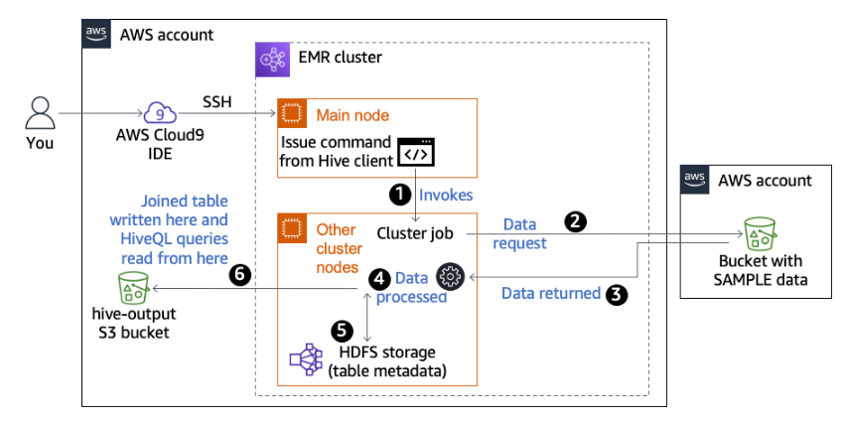
Lab: Processing Logs by Using Amazon EMR
In this lab, you will use Amazon EMR to process logs that are stored in an S3 bucket.
To process the data in Amazon EMR, you will use Apache Hive.
Hive is an open-source data warehouse infrastructure framework that is built on top of Hadoop and is often used to process large datasets.
With Hive, you can query large datasets with SQL-like queries.
When you run a Hive query, the request is translated into a Yet Another Resource Negotiator (YARN) job. YARN is the part of the Hadoop software that coordinates job scheduling.
After completing this lab, you should be able to do the following:
Launch an EMR cluster through the AWS Management Console.
Run Hive interactively.
Use Hive commands to create tables from log data that is stored in Amazon S3.
Use Hive commands to join tables and store the joined table in Amazon S3.
Use Hive to query tables that are stored in Amazon S3.

